Slide 1


Green Pace
Security Policy Presentation
Developer: Joe Andersen

Slide 2

OVERVIEW: DEFENSE IN DEPTH
Ensures Code Is Secure
Guarantee’s Code Meets A Defined Standard
Ensures Security Is Present Throughout Every Application Layer
Automation Can Be Used To Validate Code Meets The Defined Standard
Code Implementations Become Uniformed Due To Having A Defined Approach

Slide 3
THREATS MATRIX
Likely Data Type Data Value String Correctness SQL Injection | Priority Memory Protection
Low priority Assertions | Unlikely Exceptions
[Populate the Threats Matrix table and provide explanations to summarize of all of your security risks.]

Slide 4
10 PRINCIPLES
Validate Input Data
STD-002-CPP - Prevent Buffer Overflow by Validating Input
STD-004-CPP - Prevent SQL Injection by using a data dictionary
Heed Compiler Warnings
Architect and Design for Security Policies
STD-006-CPP - Use a static assertion to test the value of a constant expression
STD-007-CPP - Do not reference base classes or class data members in a constructor or destructor function-try-block handler
Keep It Simple
STD-001-CPP - Use only explicitly signed or unsigned char type for numeric values
STD-010-CPP - Use valid iterator ranges
Default Deny
Adhere to the Principle of Least Privilege
STD-008-CPP - Do not leak resources when handling exceptions
Sanitize Data Sent to Other Systems
STD-003-CPP - Do not pass a non-null-terminated character sequence to a library function that expects a string
STD-004-CPP - Prevent SQL Injection by using a data dictionary
Practice Defense in Depth
Use Effective Quality Assurance Techniques
STD-009-CPP - Avoid using default operator new for over-aligned types
Adopt a Secure Coding Standard
STD-005-CPP - Properly deallocate dynamically allocated resources

Slide 5
CODING STANDARDS
STD-001-CPP - Use only explicitly signed or unsigned char type for numeric values
STD-002-CPP - Prevent Buffer Overflow by Validating Input
STD-003-CPP - Do not pass a non-null-terminated character sequence to a library function that expects a string
STD-004-CPP - Prevent SQL Injection by using a data dictionary
STD-005-CPP - Properly deallocate dynamically allocated resources
STD-006-CPP - Use a static assertion to test the value of a constant expression
STD-007-CPP - Do not reference base classes or class data members in a constructor or destructor function-try-block handler
STD-008-CPP - Do not leak resources when handling exceptions
STD-009-CPP - Avoid using default operator new for over-aligned types
STD-010-CPP - Use valid iterator ranges

Slide 6
ENCRYPTION POLICIES
At Rest
Data Classifications
Secrets such as credentials shall not be stored as plain text.
In Flight
Firewalls and network access controls
Protect against malware attacks
Protect against network intrusions
In Use
Decrypted data is permitted for such purpose as reporting or visualization
Any decrypted data cannot be transferred to a personal device
Decrypted data is not to leave a company location or approved event

Slide 7
TRIPLE-A POLICIES
Authentication
User Management
Active Directory
Control System Access, Roles, and Permissions through one service
Authorization
Role-based Access Controls
Data Accessibility Is Permitted Through Pre-defined Roles
Shared Storage Spaces, Applications, and Databases
Accounting
Monitor User Usage
Security Information and Event Management Tool
Intelligence That Scans For Suspicious Activity

Slide 8
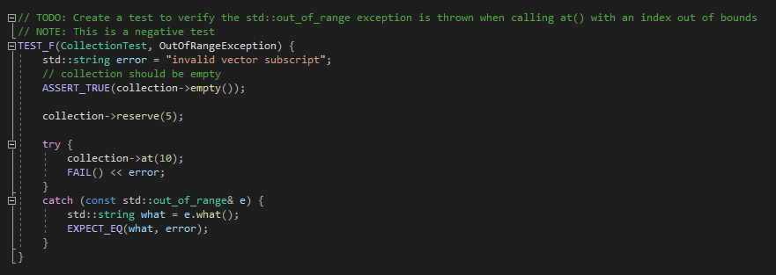
Unit Testing
Out Of Range Exception

Slide 9
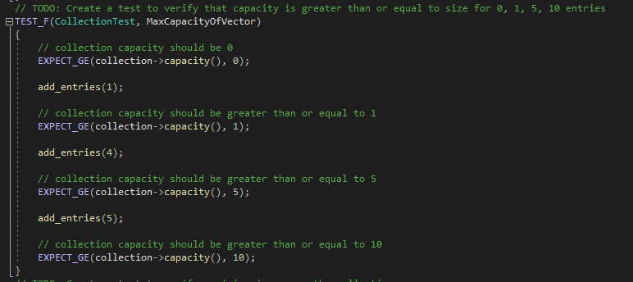
Unit Testing
Max Capacity Of Vector

Slide 10
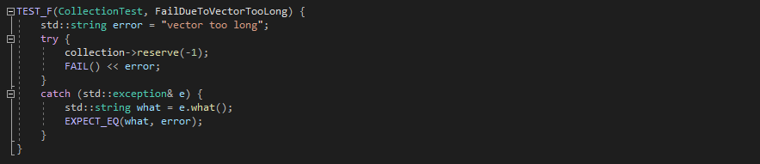
Unit Testing
Fail Due To Vector Too Long

Slide 11
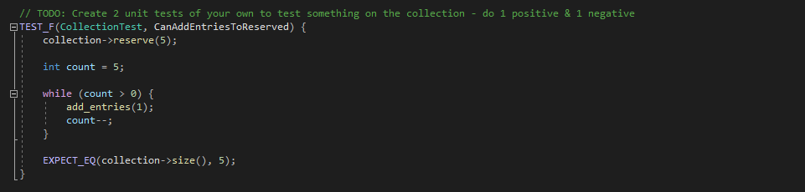
Unit Testing
Can Add Entries To Reserved

Slide 12

AUTOMATION SUMMARY

Slide 13
TOOLS
Astrée
Helix QAC
Parasoft C/C++test
PVS-Studio
Polyspace Bug Finder
CodeSonar
LDRA tool suite
Axivion Bauhaus Suite
RuleChecker
ECLAIR
Clang
Coverity
Klocwork
Compass/ROSE

Slide 14
RISKS AND BENEFITS
Risks
Malware Attacks
Loss Of Company Data
Ransomware Attacks
Damage To The Companies Reputation
Benefits
Clean Secure Code
New Employees Have A Starting Point
Defense In Depth
Easier Path To Automation

Slide 15
RECOMMENDATIONS
Firewall
What is our policy for remote IP address access to the network?
How will online programs access the internet?
Who can see our network?
What types of website content is viewable?

Slide 16
CONCLUSIONS
Static Analysis
Code Scanning
Increased Unit Testing
Shift Security Measures Left To Start Threat Detection Earlier In the Development Lifecycle

Slide 17
REFERENCES
Seacord, R. C. (2013). Secure Coding in C and C. [MBS Direct]. Retrieved from https://mbsdirect.vitalsource.com/#/books/9780132981972/
Confluence. INT07-C. Use only explicitly signed or unsigned char type for numeric values - SEI CERT C Coding Standard - Confluence. (n.d.). https://wiki.sei.cmu.edu/confluence/display/c/INT07-C.+Use+only+explicitly+signed+or+unsigned+char+type+for+numeric+values.
Confluence. STR32-C. Do not pass a non-null-terminated character sequence to a library function that expects a string - SEI CERT C Coding Standard - Confluence. (n.d.). https://wiki.sei.cmu.edu/confluence/display/c/STR32-C.+Do+not+pass+a+non-null-terminated+character+sequence+to+a+library+function+that+expects+a+string.
Confluence. MEM51-CPP. Properly deallocate dynamically allocated resources - SEI CERT C++ Coding Standard - Confluence. (n.d.). https://wiki.sei.cmu.edu/confluence/display/cplusplus/MEM51-CPP.+Properly+deallocate+dynamically+allocated+resources.
Confluence. DCL03-C. Use a static assertion to test the value of a constant expression - SEI CERT C Coding Standard - Confluence. (n.d.). https://wiki.sei.cmu.edu/confluence/display/c/DCL03-C.+Use+a+static+assertion+to+test+the+value+of+a+constant+expression.

Slide 18
REFERENCES
Confluence. ERR53-CPP. Do not reference base classes or class data members in a constructor or destructor function-try-block handler - SEI CERT C++ Coding Standard - Confluence. (n.d.). https://wiki.sei.cmu.edu/confluence/display/cplusplus/ERR53-CPP.+Do+not+reference+base+classes+or+class+data+members+in+a+constructor+or+destructor+function-try-block+handler.
Confluence. ERR57-CPP. Do not leak resources when handling exceptions - SEI CERT C++ Coding Standard - Confluence. (n.d.). https://wiki.sei.cmu.edu/confluence/display/cplusplus/ERR57-CPP.+Do+not+leak+resources+when+handling+exceptions.
Confluence. MEM57-CPP. Avoid using default operator new for over-aligned types - SEI CERT C++ Coding Standard - Confluence. (n.d.). https://wiki.sei.cmu.edu/confluence/display/cplusplus/MEM57-CPP.+Avoid+using+default+operator+new+for+over-aligned+types.
Confluence. CTR53-CPP. Use valid iterator ranges - SEI CERT C++ Coding Standard - Confluence. (n.d.). https://wiki.sei.cmu.edu/confluence/display/cplusplus/CTR53-CPP.+Use+valid+iterator+ranges.
Confluence. STR50-CPP. Guarantee that storage for strings has sufficient space for character data and the null terminator - SEI CERT C++ Coding Standard - Confluence. (n.d.). https://wiki.sei.cmu.edu/confluence/display/cplusplus/STR50-CPP.+Guarantee+that+storage+for+strings+has+sufficient+space+for+character+data+and+the+null+terminator.

Slide 19
REFERENCES
Confluence. STR02-C. Sanitize data passed to complex subsystems - SEI CERT C Coding Standard - Confluence. (n.d.). https://wiki.sei.cmu.edu/confluence/display/c/STR02-C.+Sanitize+data+passed+to+complex+subsystems.
Bowman, M. from B., Bowman, B., Adam Strange | 2 days ago, Kyle Marchini | 3 days ago, Mike Nelson | 3 days ago, Richi Jennings | 2 days ago, Richi Jennings | 4 days ago, &amp; 07, R. J. | J. (2019, March 18). The AAA Framework for Identity Access Security. Security Boulevard. https://securityboulevard.com/2019/03/the-aaa-framework-for-identity-access-security/#:~:text=The%20AAA%20Framework%20is%20a,for%20Authenticate%2C%20Authorize%20and%20Account.
The firewall – the security guard standing between computers and networks. IONOS Digitalguide. (n.d.). https://www.ionos.com/digitalguide/server/security/what-is-a-firewall/.
bizjournals.com. (n.d.). https://www.bizjournals.com/phoenix/news/2018/11/15/why-every-business-needs-a-firewall.html.

